Slide 1

Media Analysis Project: LinkedIn & Facebook Dashboard Analysis
Presented by: Sri Lakshmi, Madan Shetty, and Alsha Kumari | Group 6

Slide 2
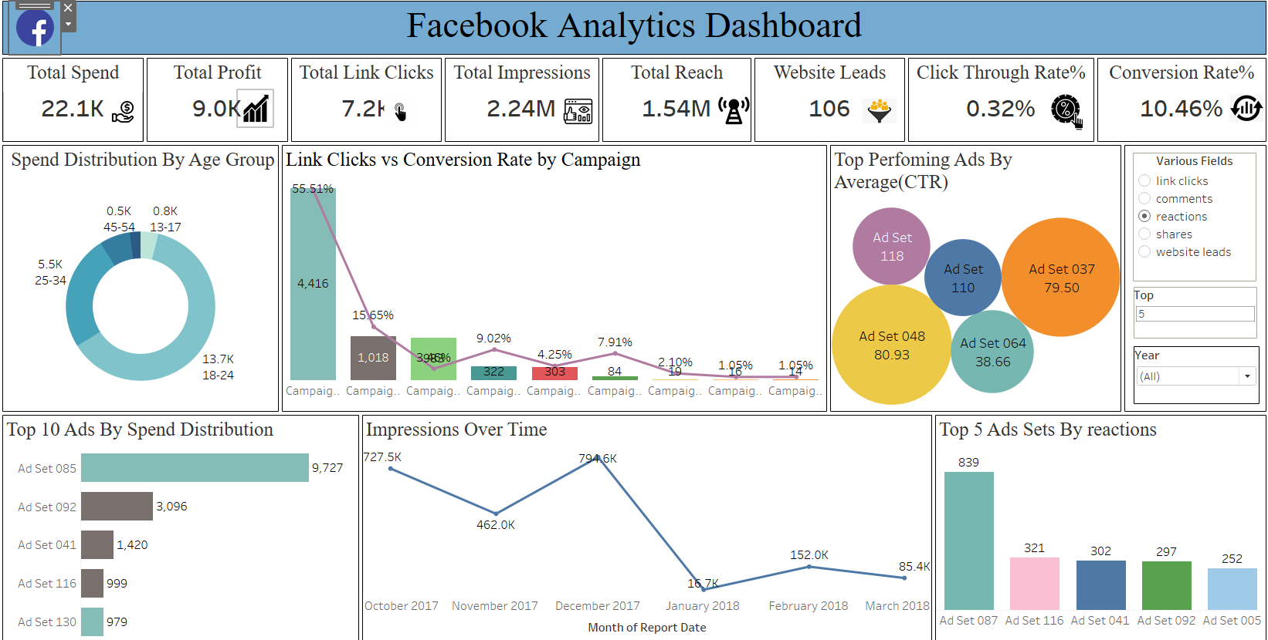



Project Objectives & Scope
Define Key Metrics
Identify crucial performance indicators.
Build Dashboards
Visualize data from LinkedIn and Facebook.
Derive Insights
Analyze trends for strategic recommendations.

Slide 3
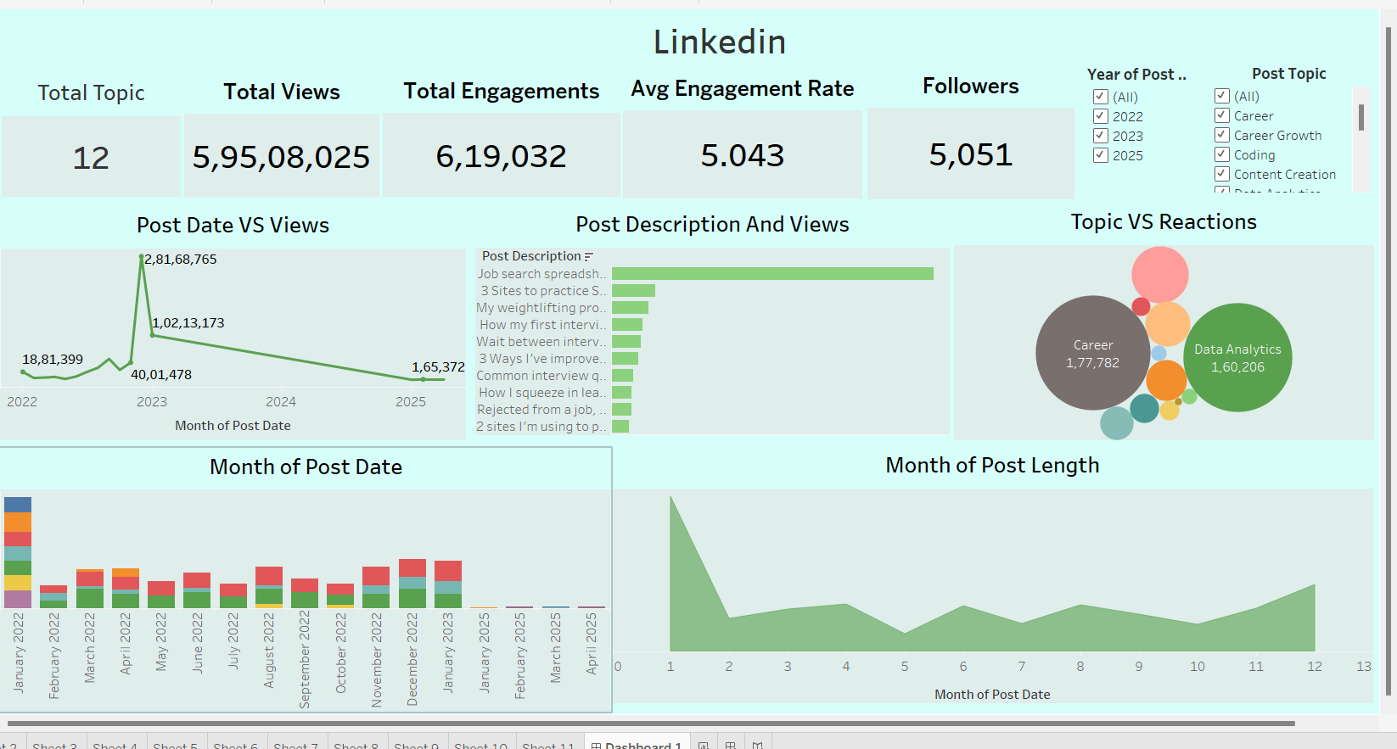



Data Collection & Preparation
Extract Data
Retrieve raw data from platforms.
Cleanse & Transform
Format for consistency and accuracy.
Integrate Datasets
Combine LinkedIn and Facebook data.

Slide 4
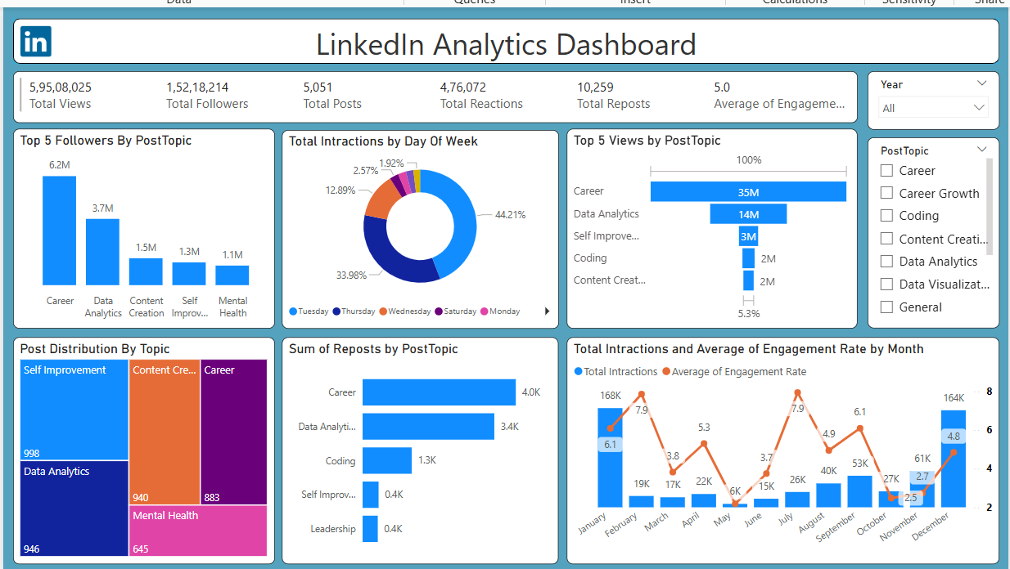
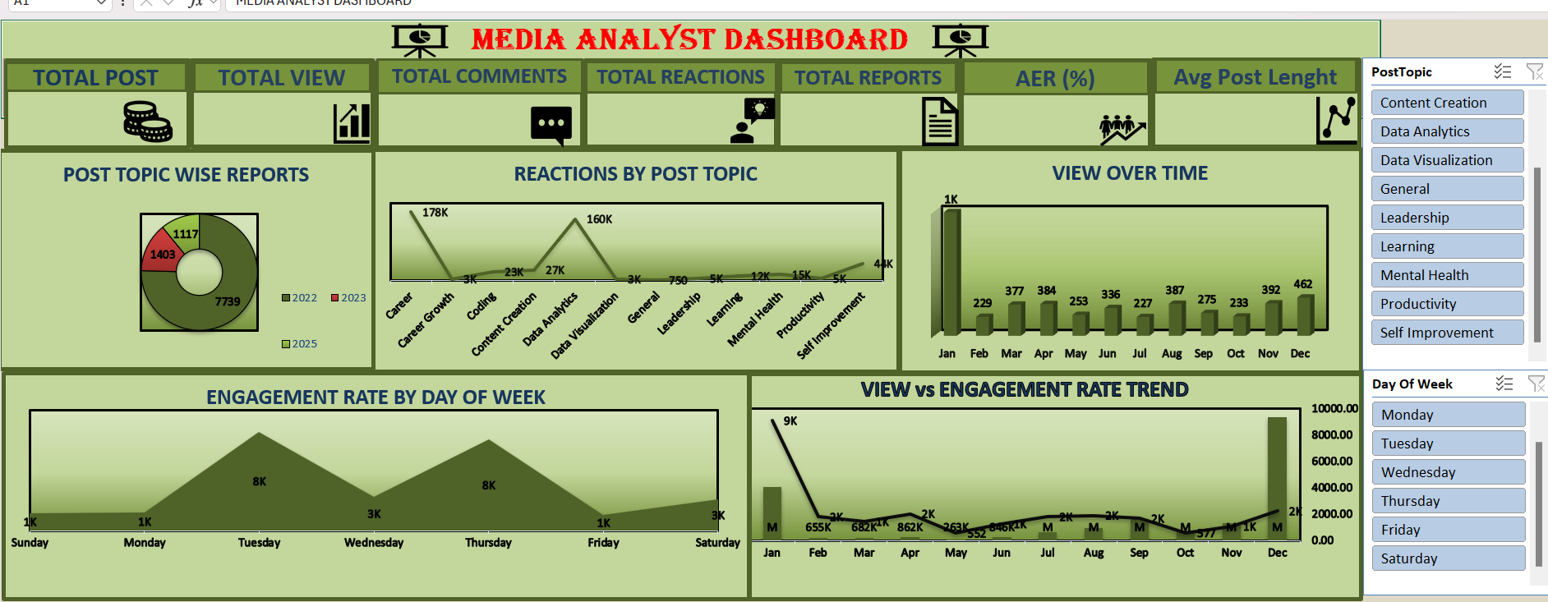
LinkedIn Dashboard Overview
Key Metrics
Audience Demographics
Follower growth
Job titles
Post engagement
Industries
Impressions
Company sizes

Slide 5
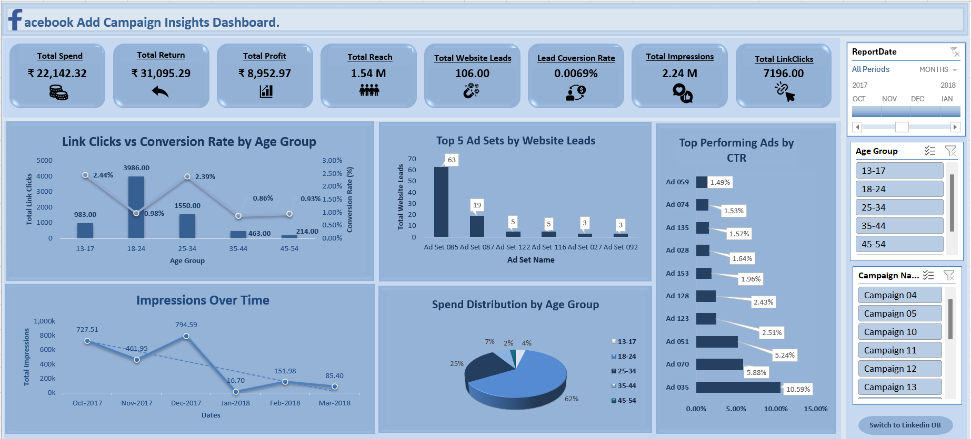
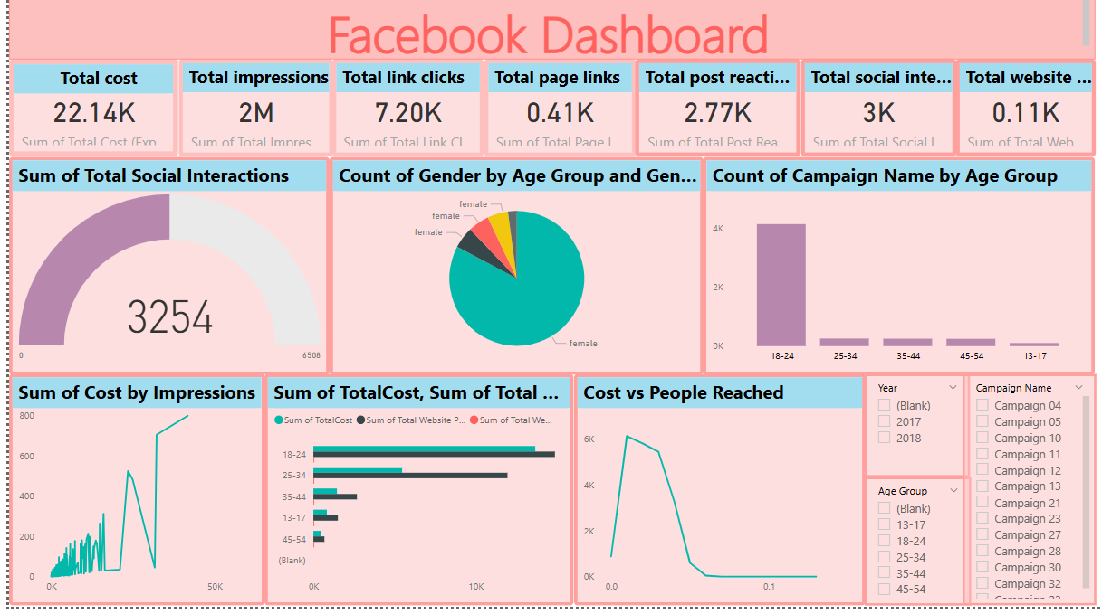
Facebook Dashboard Overview
Engagement Rates
Reach & Impressions
Audience Interests
Likes, shares, comments, reactions.
How many unique users saw content.
Detailed insights into user preferences.

Slide 6
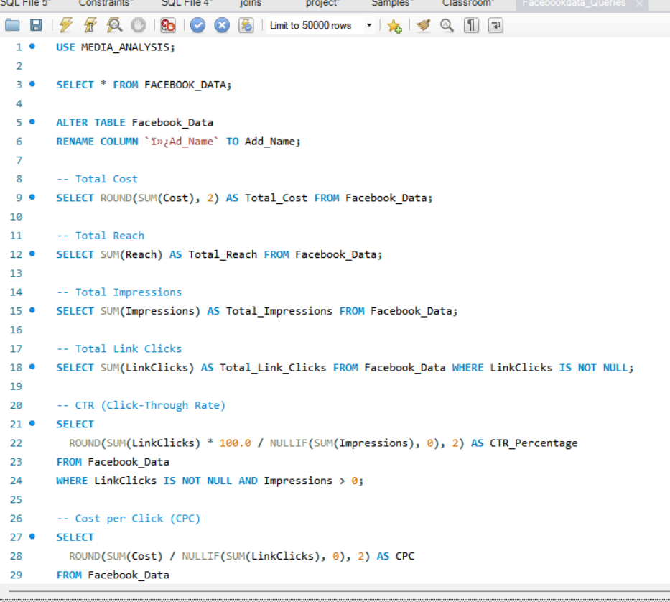
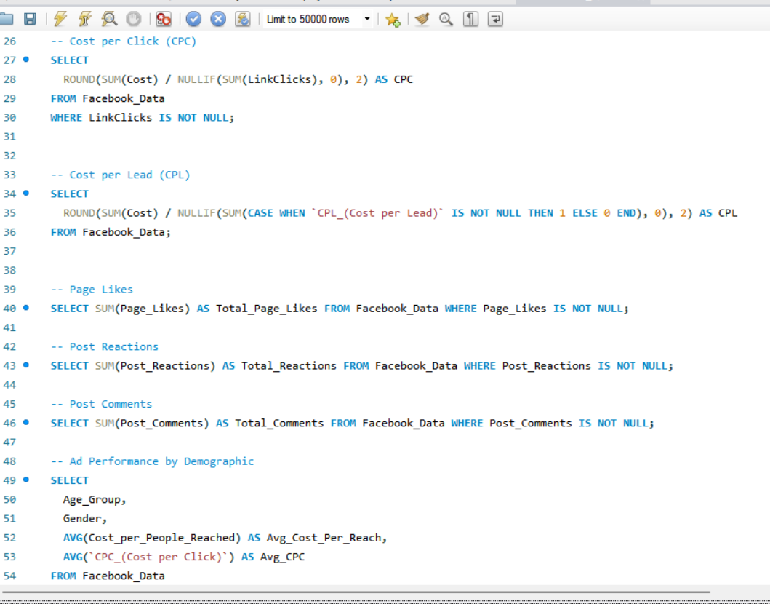
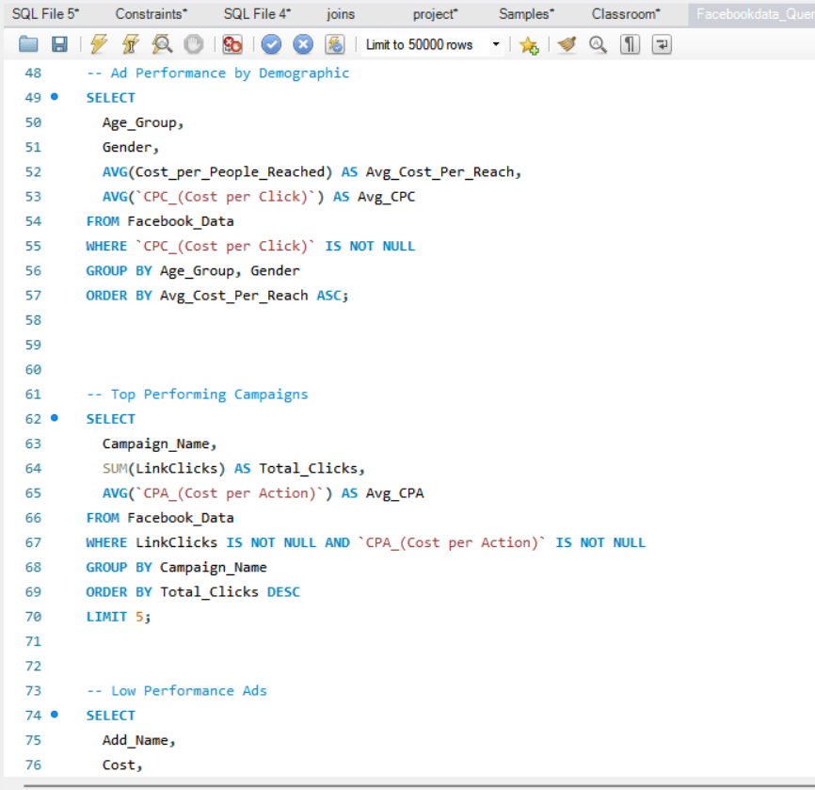



Facebook-SQL Queries
Facebook Audience
Diverse, interest-driven.
LinkedIn Audience
Overlap
Professional, industry-focused.
Segments with presence on both.

Slide 7
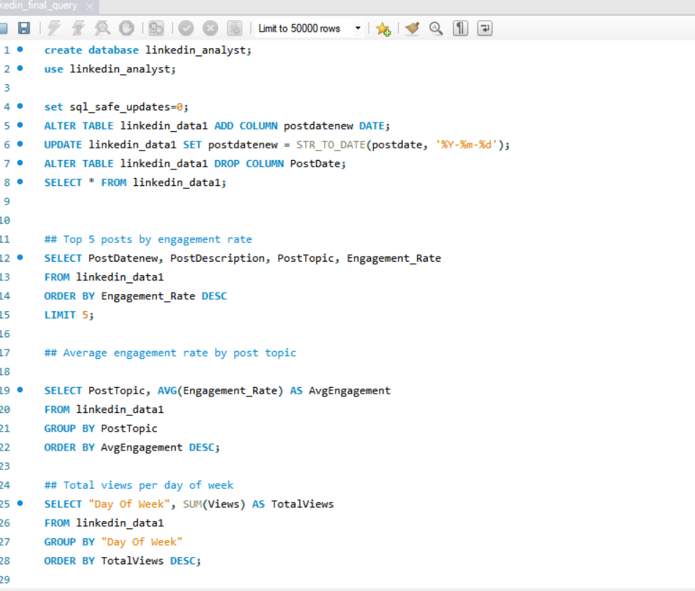
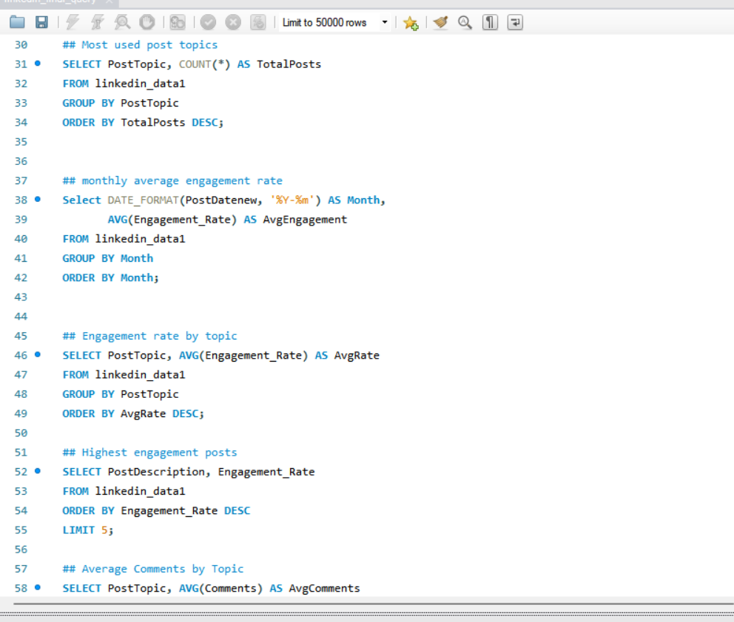
LinkedIn SQL Queries

Slide 8



Key Takeaways
Content Optimization
1
Tailor content for each platform.
Audience Targeting
2
Leverage unique demographic data.
Performance Monitoring
Continuous dashboard analysis is key.
3

Slide 9
Recommendations & Next Steps
1
A/B Test Campaigns
Experiment with different content formats.
Refine Targeting
2
Utilize platform-specific features.
Automate Reporting
3
Streamline data analysis with tools.

Slide 10
Thank You

